Slide 1


Predicting Autism Spectrum Disorder (ASD) in Toddlers
Capstone DATA 2206
Professor Sam Plati
Group Name : Insight shapers
SHAILI JANI (100958447)
HETAL PARMAR (100992608)
ZANKHANA PANCHAL (100930835)
AISHWARYA SRINATH (100976180)
GIFT CLARA (100924338)
DIPKUMAR PANCHAL (100944384)

Slide 2


Overview
Problem Statement: ASD diagnosis is often delayed, limiting access to early intervention.
Objective: Build a predictive model using questionnaire and demographic data to identify ASD traits early.
Significance: Early detection improves cognitive, language, and behavioral outcomes
Imagine if a simple survey could change a child's future.

Slide 3
Dataset Overview
The dataset, compiled by the research team from the Department of Digital Technology at Manukau Institute of Technology, New Zealand, includes:
•Ten behavioral features (Q-Chat-10)
•Additional individual characteristics
Data Type: Predictive and Descriptive: Nominal / categorical, binary, and continuous
Task: Classification
Attribute Type: Categorical, continuous, and binary
Area: Medical, health and social science
Number of Instances (records in your data set): 1054
Independent Variables
•Behavioral Features (Q-Chat-10): "A1", "A2", "A3", "A4", "A5", "A6", "A7", "A8", "A9", "A10"
•Other individual features: Age_Mons, Sex, Ethnicity, Jaundice, Family_mem_with_ASD, Who completed the test
Dependent Variables
•Class/ASD Traits (Yes/No):Indicates whether the individual has ASD or not

Slide 4
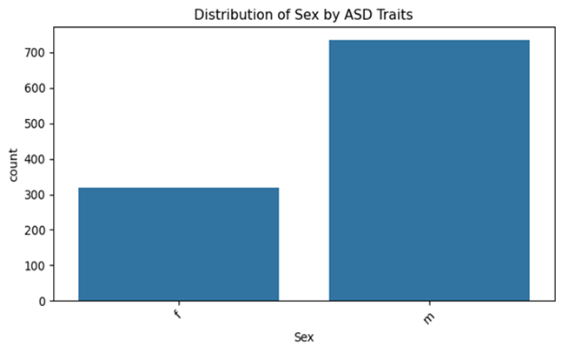
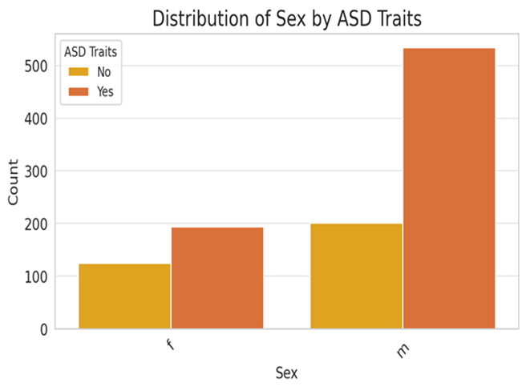
Exploratory Data Analysis (EDA)
Key Insights:
1. Gender Distribution of ASD Traits
•A significantly higher number of males exhibit ASD traits compared to females.
•This trend aligns with existing research indicating higher ASD diagnosis rates in males.
•Contributing factors may include biological, genetic, and social influences.

Slide 5
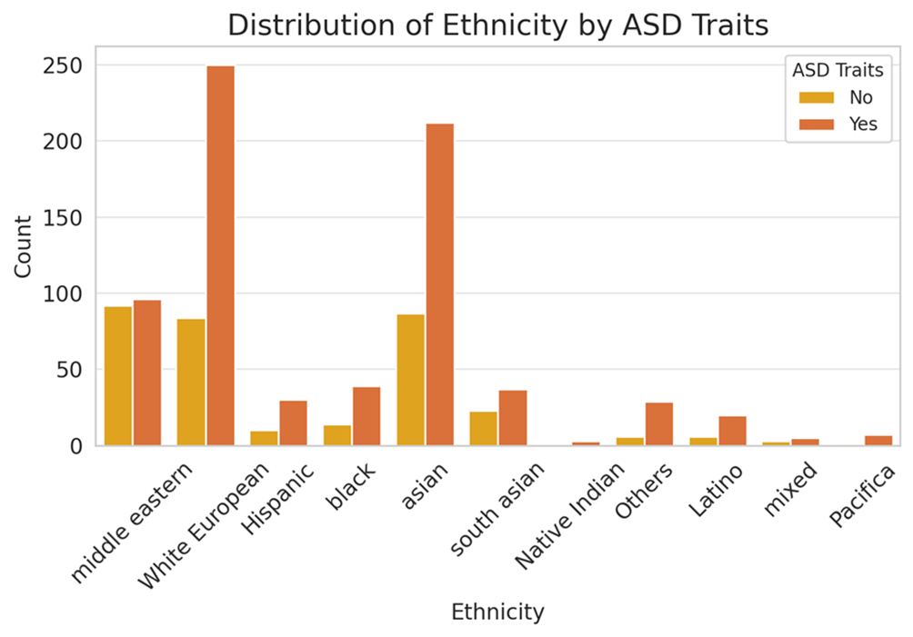
Exploratory Data Analysis (EDA)
Key Insights:
2. Ethnic Distribution in Dataset
•Most participants are of White European and Asian descent.
•Middle Eastern participants also form a sizable group.
•Other ethnicities (e.g., Hispanic, Black, Native Indian) are underrepresented.
•Possible sampling bias in data collection.

Slide 6
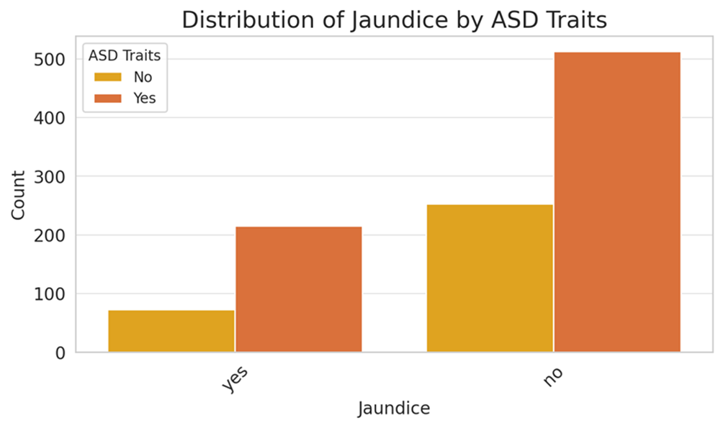
Exploratory Data Analysis (EDA)
Key Insights:
3. Neonatal Jaundice & ASD Correlation
•A portion of individuals with ASD traits reported a history of neonatal jaundice.
•However, the majority did not have jaundice.
•Literature suggests a potential but inconclusive link.

Slide 7



Modeling Approach

Slide 8



Modeling Approach
Methods Overview: We evaluated several classification models, including logistic regression, decision trees, and random forests, to determine which performed best for detecting ASD traits.
Logistic Regression: Chosen for its simplicity and ability to serve as a reliable baseline model.
Decision Tree: Selected for its ease of interpretation and ability to handle both numerical and categorical data.
Random Forest: Used to leverage ensemble learning and capture more complex feature interactions and non-linear patterns in the data.
Preprocessing Steps: One-hot encoding for categorical variables, standardization of numerical features, and SMOTE to balance the dataset due to class imbalance.

Slide 9
Modeling
Outputs
Logistic Regression
Random Forest
Decision Tree

Slide 10
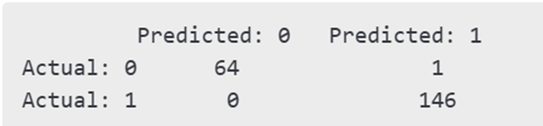
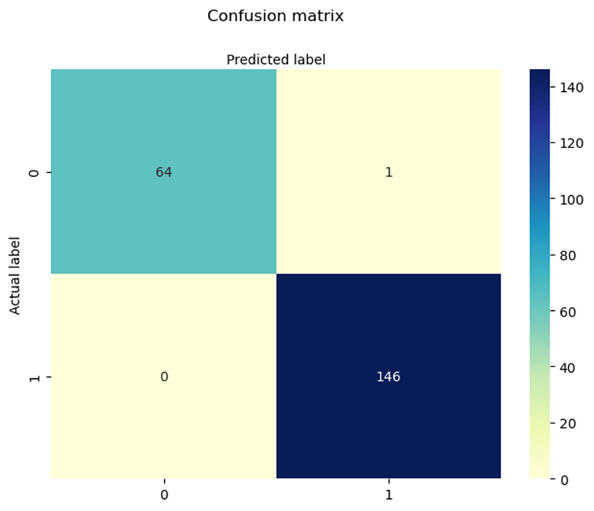
Model Outputs: Logistic Regression
Accuracy: 96.7%
Precision: 96.3%
Recall: 99.3%
F1 Score: 97.8%
AUC: 0.981
Insight: Strong baseline performance, low false negatives, but limited in modeling complex interactions or non-linear patterns

Slide 11
Model Outputs: Decision Tree and Random Forest
Decision Tree Performance
Accuracy: 99.5%
Precision: 99.3%
Recall: 100%
F1 Score: 99.6%
AUC: 1.00
Insight: Very high accuracy and perfect recall. The model captured patterns effectively but may risk overfitting the training data.
Random Forest Performance
Accuracy: 99.5%
Precision: 99.3%
Recall: 100%
F1 Score: 99.6%
AUC: 1.00
Insight: Best overall performer. Balanced accuracy and generalization. Feature importance insights support transparency and model trust.

Slide 12
Evaluation Metrics
Insight:
Accuracy: Overall rate of correct predictions.
Precision: Correct ASD predictions out of all predicted ASD cases.
Recall: Correctly identified ASD cases out of all actual ASD cases.
F1 Score: Balance between precision and recall.
AUC-ROC: Measures how well the model separates ASD and non-ASD classes.
Random Forest and Decision Tree had perfect recall — all ASD cases were correctly identified.
Logistic Regression was a solid baseline with few errors.
All models had high AUC, confirming excellent classification performance.

Slide 13
Implication
Practical Applications:
Healthcare Use: Pediatricians and general practitioners can use this model as a preliminary screening tool to flag potential ASD cases early, even before a formal clinical diagnosis.
Educational Integration: Early childhood educators and school counselors can apply the model to monitor behavioral patterns and initiate early interventions.
Digital Accessibility: Mobile apps or online platforms can deploy the model for parent-led screening at home, enabling broader and quicker reach.
Clinical Support: Clinics with limited access to trained ASD specialists can use the model to prioritize children who need full assessments, improving operational efficiency.
Potential Impact:
Early Interventions: Early screening leads to timely therapies and support, significantly improving a child’s long-term cognitive, emotional, and social outcomes.
Reduced Diagnostic Delay: Automating early detection can help reduce the typical waiting time for diagnosis, which can span months or even years in many regions.
Resource Efficiency: The model helps healthcare systems allocate specialists, therapy services, and educational resources more strategically based on evidence-based risk assessment.
Policy Implications: School boards or health ministries could adopt such models to create standardized early screening protocols that scale across regions.

Slide 14
Limitations:
Actionable Next Steps:
Demographic Bias: The dataset primarily represents toddlers from a single region; more diversity is needed for general use.
Behavioral Nuance: Some subtle behavioral cues may not be captured through the questionnaire format alone.
Model Refinement: Apply k-fold cross-validation and hyperparameter tuning to improve model robustness and generalizability.
Explainability Tools: Integrate SHAP or LIME to improve interpretability of model predictions and increase trust in clinical settings.
External Validation: Test the model using independent datasets from different geographic or demographic populations to ensure consistent accuracy.
Future Work
Time-Series Analysis: Investigate longitudinal data to observe developmental changes and improve prediction over time.
Multimodal Inputs: Incorporate video or audio data (e.g., speech patterns, facial expressions) to improve model sensitivity.
Public Health Implementation: Explore collaboration with government and healthcare institutions to pilot screening programs in schools and clinics.

Slide 15


Conclusion
Our project identified key predictors of ASD in toddlers, developed and evaluated machine learning models, and demonstrated the success of a Random Forest-based screening system.
We emphasized the importance of using behavioral and demographic data to build accessible, early-intervention tools.
This project shows how predictive modeling can shift ASD care from reactive to proactive.
With implementation, it can lead to earlier diagnoses, better outcomes, and more efficient healthcare planning.
Key Takeaways

Slide 16

That’s the end of the presentation
Thank you ☺

